Slide 1
Analysis in Machine Learning models for Sentiment Analysis
Team Sentiment - Boyeon Park, Moonjeog Choi

Slide 2
TABLE OF CONTENTS
01
02
03
04
PROBLEM
METHOD
EXPERIMENT
KEY FINDINGS

Slide 3
01
PROBLEM

Slide 4
PROBLEM
TOPIC
GOALS
DATA
Analysis of 5 models : Naive bayes, K-Nearest-Neighbor, Logistic regression, Gradient Boosting, LSTM
Text Classification
(Sentiment Analysis)
Product reviews of fine food on Amazon
Notes:
5 models: Naive bayes, K-Nearest-Neighbor, Logistic regression, Gradient Boosting and LSTM

Slide 5
PROBLEM
TOPIC
GOALS
DATA
We chose these models because :
There are also other popular classification algorithms such as SVM, Random Forest, but they require quite long training time especially for text data, so we chose some models which have quick training time so that we can manage in our limited resources. And also we included LSTM to have better understanding which was professor’s suggestion.
Analysis of 5 models : Naive bayes, K-Nearest-Neighbor, Logistic regression, Gradient Boosting, LSTM
Text Classification
(Sentiment Analysis)
Product reviews of fine food on Amazon

Slide 6
02
METHOD

Slide 7
METHOD
1
2
3
4
EDA
Vectorizing
Pre-Processing Data
Train, Test, Valid Split
5
6
7
8
Prediction
Evaluation
Analysis
Model Building

Slide 8
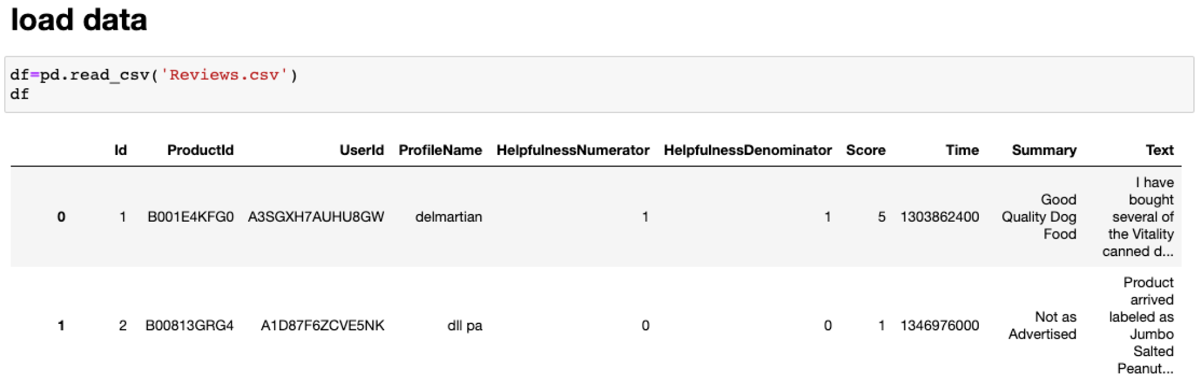
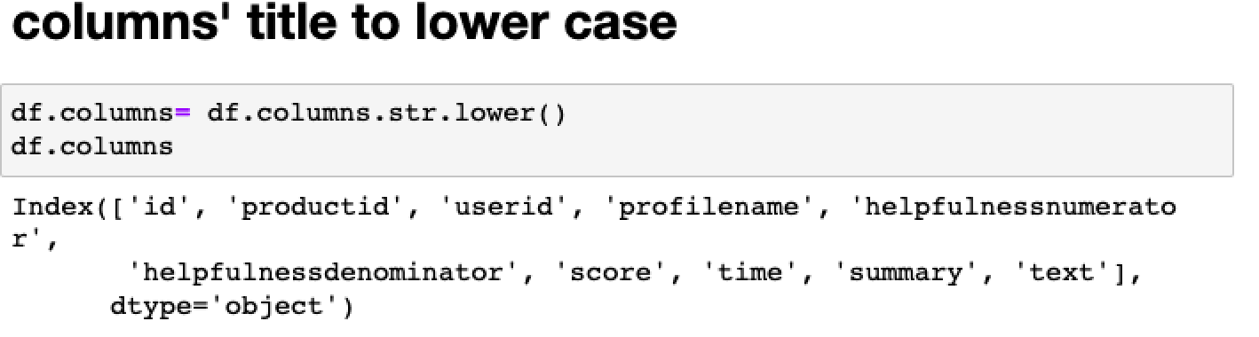
PRE-PROCESSING AND VECTORIZING
Data: Review.csv
Reviews are on fine foods from amazon
568,454 rows of reviews
10 columns, including id, productid, userid, profilename, helpfulnessnumerator, helpfulnessdenominator,score,time,summary,text

Slide 9
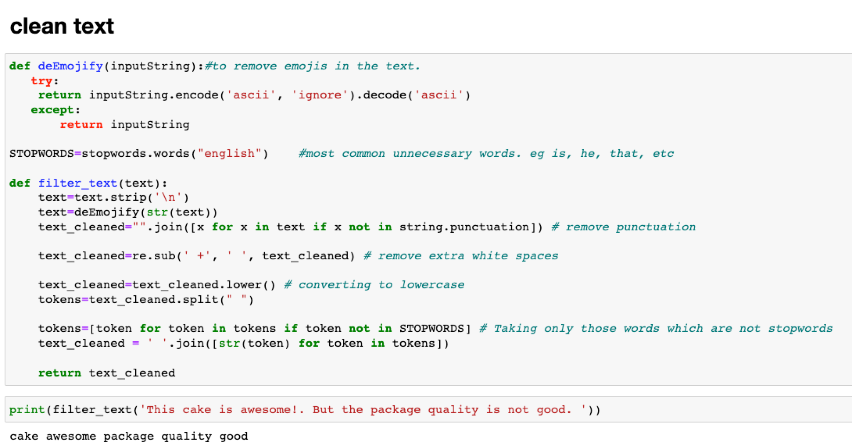
PRE-PROCESSING AND VECTORIZING Continued
Removed emoji
Removed stopwords
Removed extra white space
Removed punctuation
Convert all tokens to lowercase
Lemmatization (optional)

Slide 10
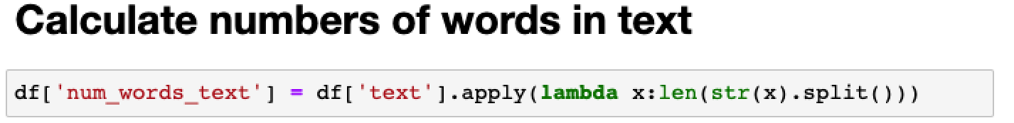
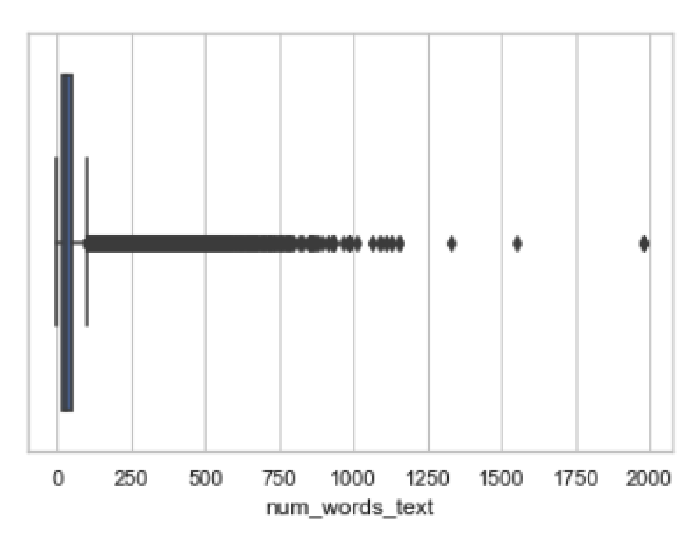
PRE-PROCESSING AND VECTORIZING Continued
Calculated length of each reviews
New column num_words_text is created
A boxplot shows more clearly the distribution of the length of reviews - abnormal length of reviews exist
Reviews that are in abnormal length will be filtered out later l

Slide 11
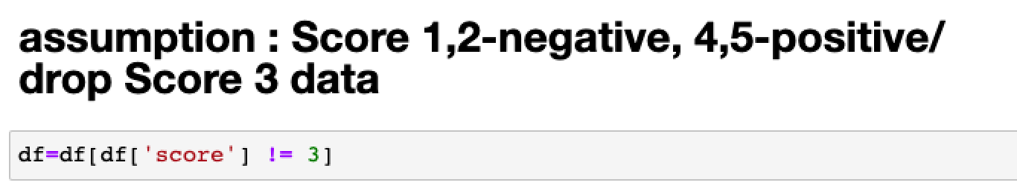
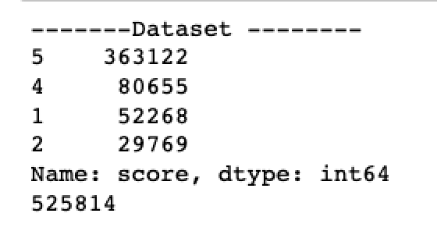
PRE-PROCESSING AND VECTORIZING Continued
Fields contain 3 in score column is removed
Keep score 1 & 2 indicating negative reviews, 4 & 5 indicating positive reviews

Slide 12
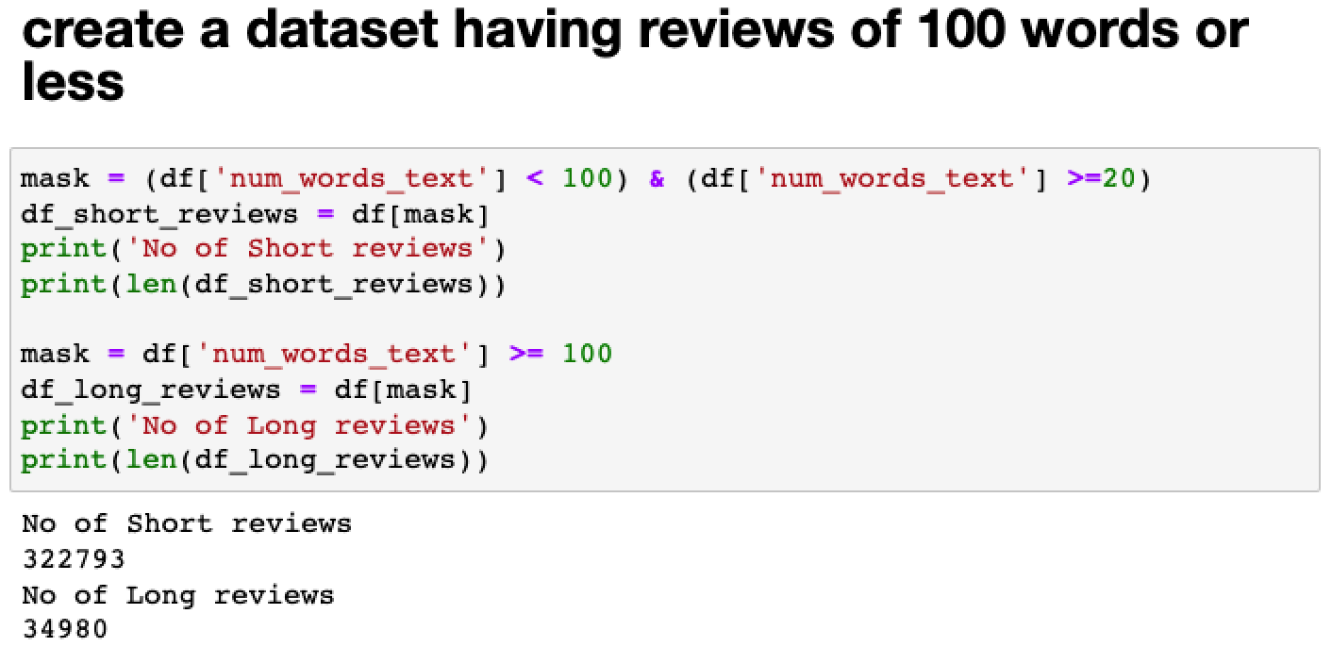
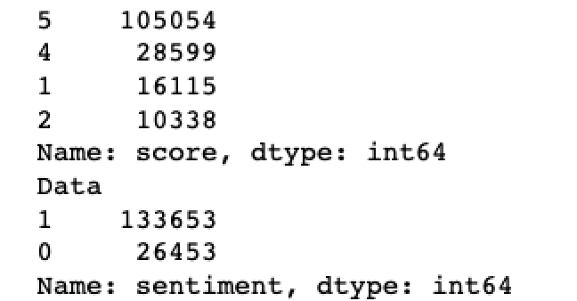
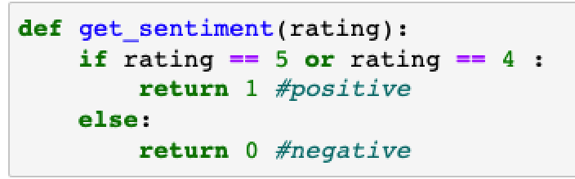
PRE-PROCESSING AND VECTORIZING Continued
Only keep short reviews that have words more than 20 less than 100
Group score 4 and 5 as 1 indicating positive reviews, 1 and 2 as 0 indicating negative reviews

Slide 13
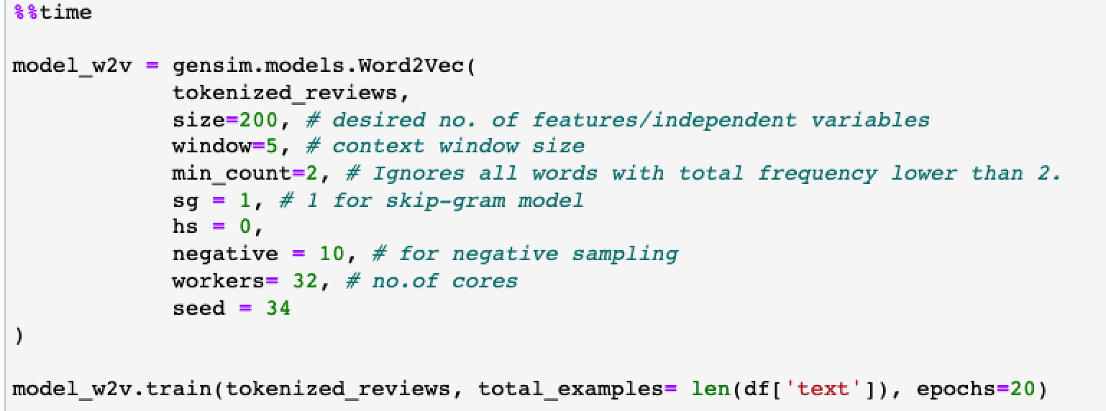
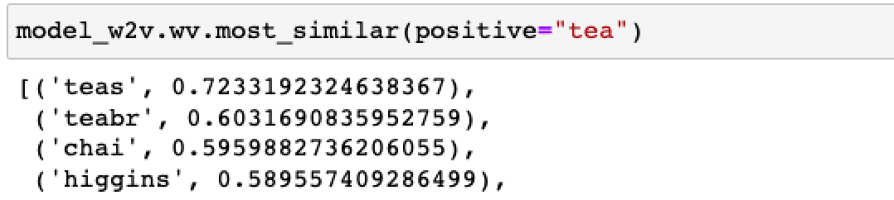
PRE-PROCESSING AND VECTORIZING Continued

Slide 14

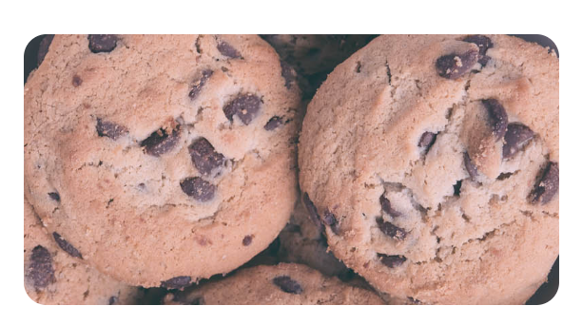


EXPLORATORY DATA ANALYSIS
Histogram
Box-plot
Word Cloud Graph

Slide 15
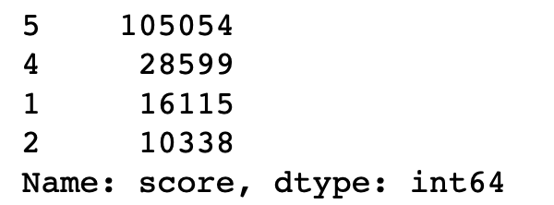
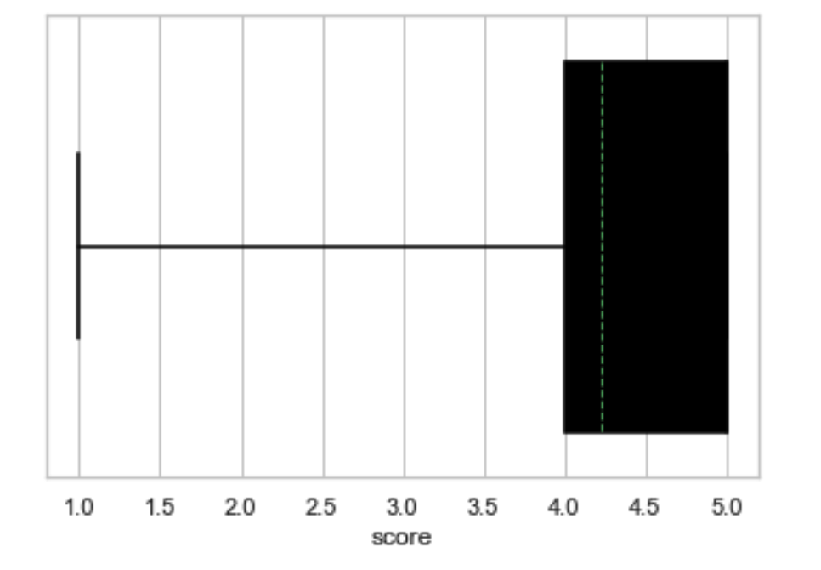
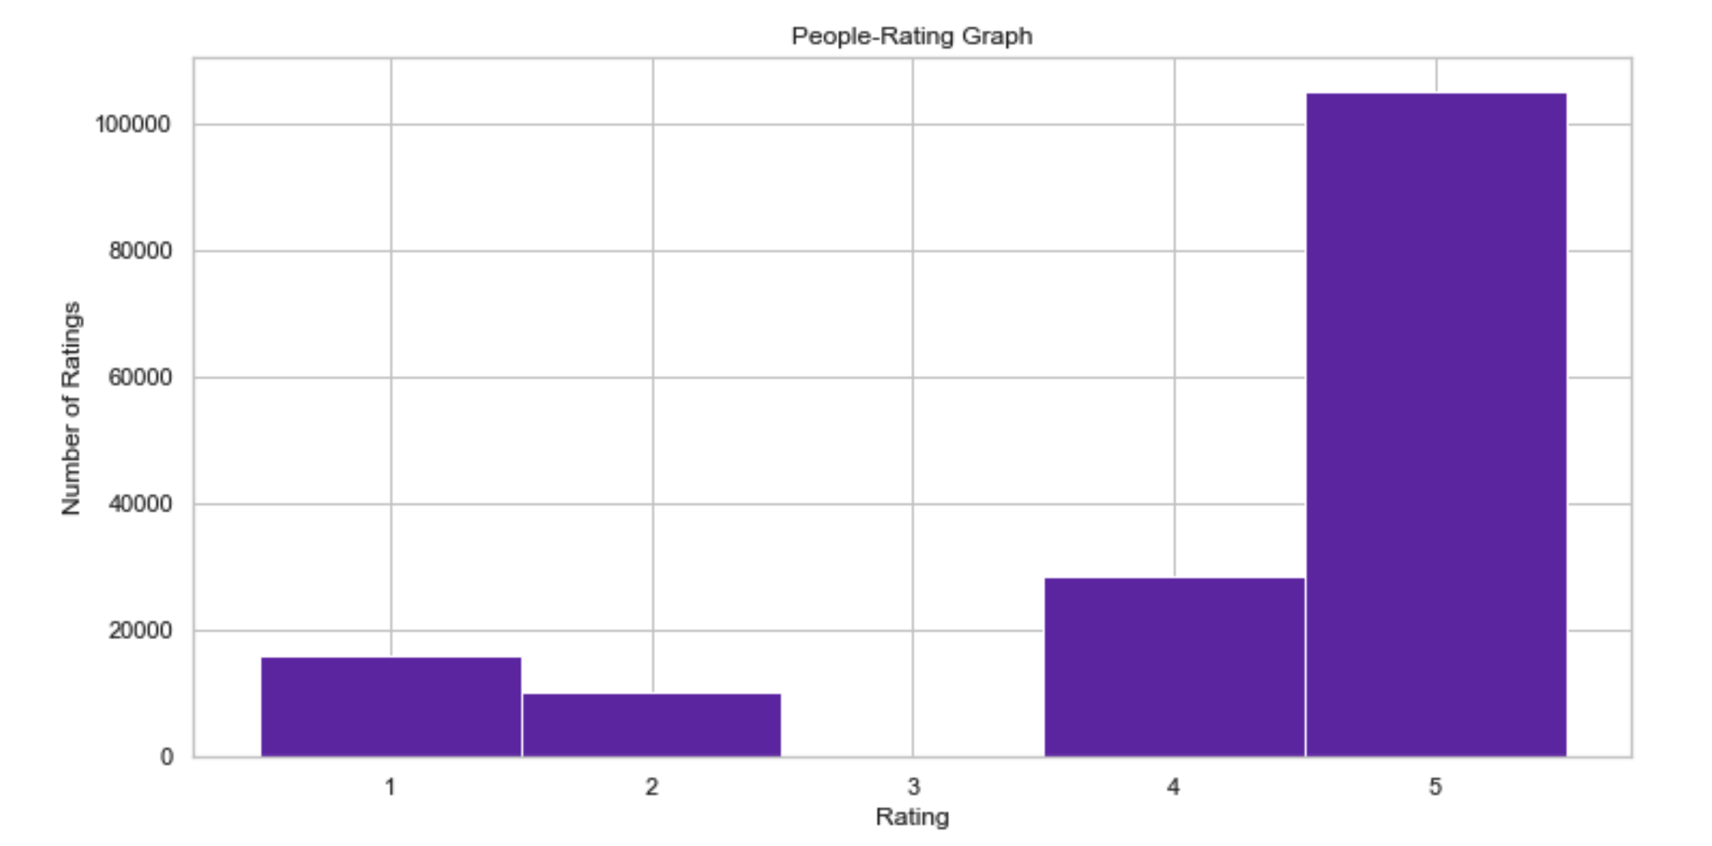
Data is skewed
High frequency of high sentiment scores

Slide 16
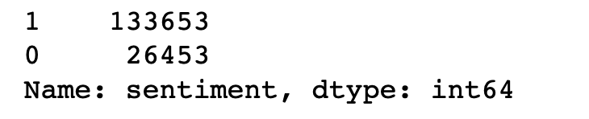
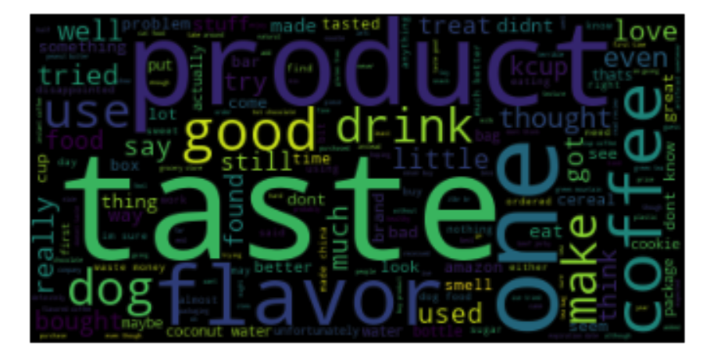
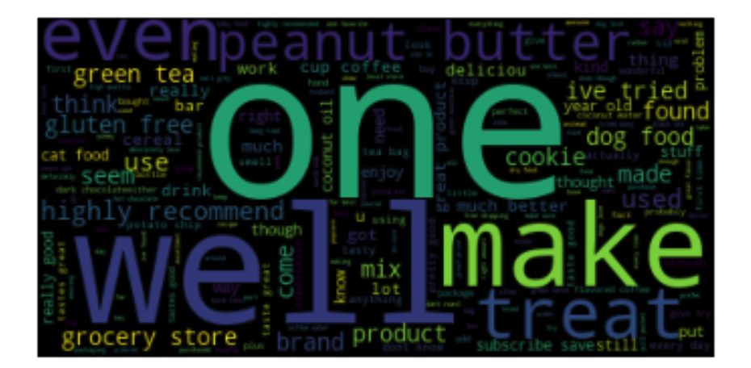
sentiment score = 0
sentiment score = 1

Slide 17
03
EXPERIMENT

Slide 18
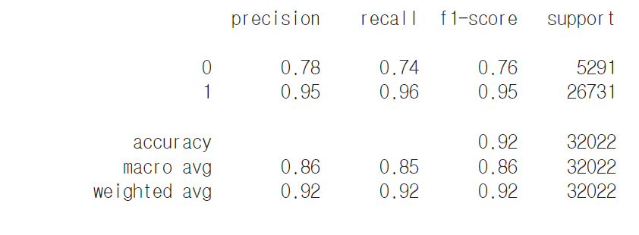
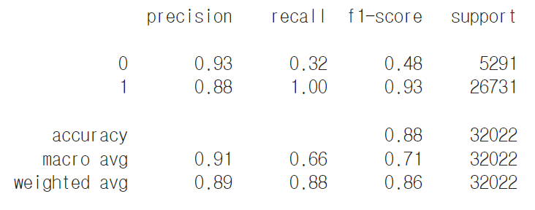
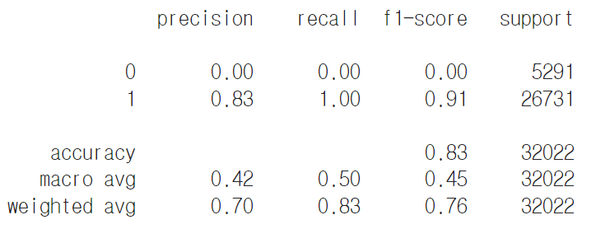
Naive Bayes
countvect
tf-idf
word2vec
Model with countvect performs best compared with tf-idf and word2vec. It has 92% accuracy.
Notes:
Countvect(92%) > tf-idf > word2vec

Slide 19
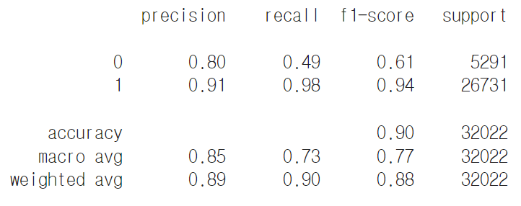
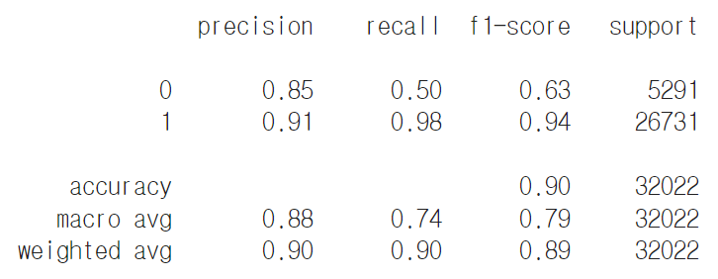
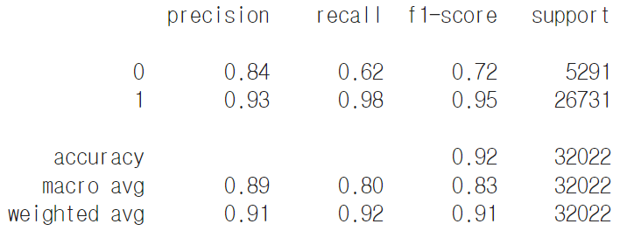
K-Nearest-Neighbor
countvect
tf-idf
word2vec
Model performs well with all of the three. Accuracy rate are 90%, 90%, and 92% respectively.
Notes:
Word2vec(92%) > tf-idf >= countvect

Slide 20
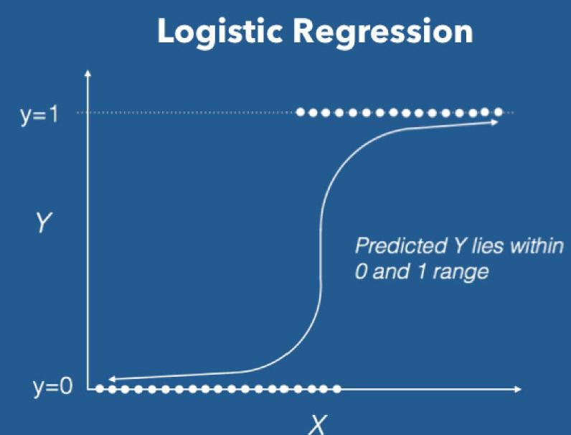
Logistic Regression
Regression using ‘sigmoid’ function
LR becomes a classifier when a decision threshold is brought
Threshold 0.5 was used which was default setting of Scikitlearn Logistic Regression classifier

Slide 21
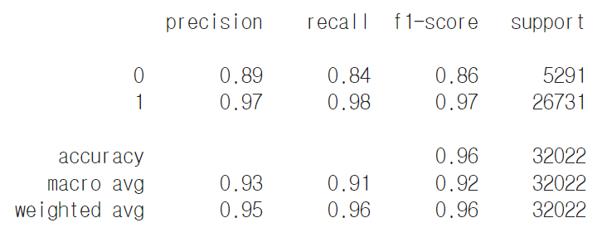
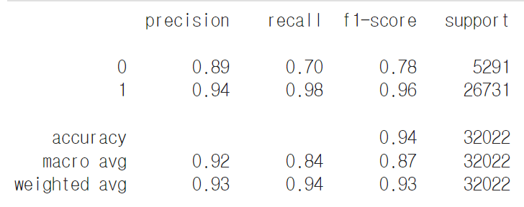
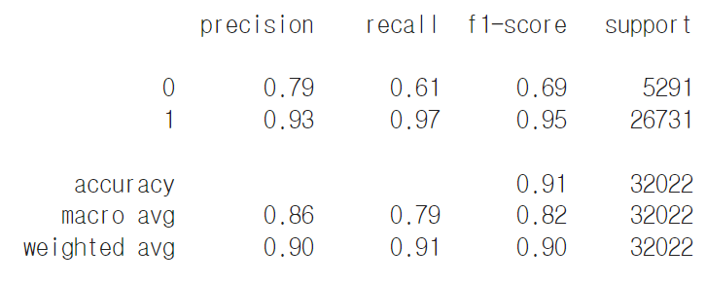
Logistic Regression
countvect
tf-idf
word2vec
The performance showed that Logistic regression performed really well, especially with count vector.
The accuracy was 96%, and 94% and 91% for count vector, tf-idf, word2vec respectively.
Notes:
countvect(96%) > tf-idf > word2vec
The performance showed that Logistic regression performed really well, especially with count vector. The accuracy was 96%, and 94% and 91% for count vector, tf-idf, word2vec respectively.

Slide 22
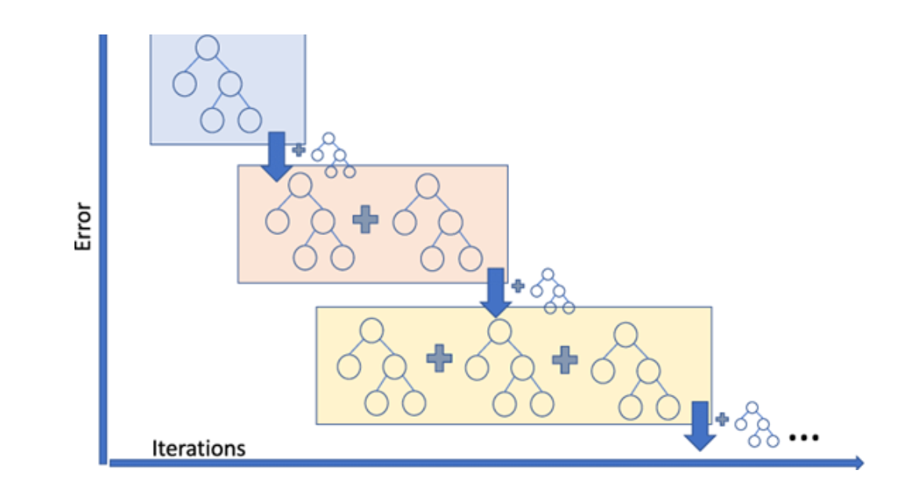
Gradient Boosting
Boosting is a method for creating an ensemble
It starts by fitting an initial model to the data. Then a second model is built that focuses on accurately predicting the cases where the first model performs poorly.
Each successive model attempts to correct for the shortcomings of the combined boosted ensemble of all previous models
Gradient boosting is a type of boosting algorithm. It relies on the intuition that the best possible next model, when combined with previous models, minimizes the overall prediction error

Slide 23

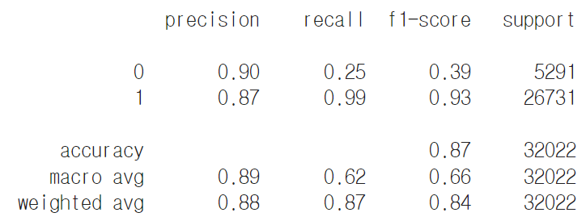
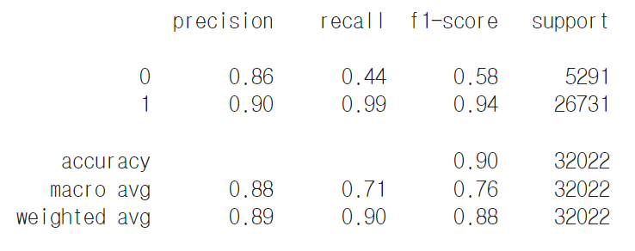
Gradient Boosting
countvect
tf-idf
word2vec
The performance showed that the accuracy was lower than other models overall.
The model with word2vec performed the best among three(90%).
We expected GB performs better than a single model since it is a type of ensemble method but it didn’t.
=> future study

Slide 24
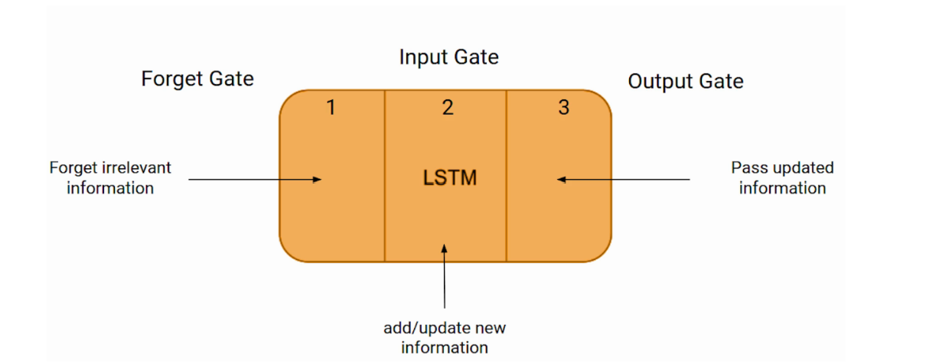
LSTM
LSTM is an advanced RNN, a sequential network, that allows information to persist. It is capable of handling the vanishing gradient problem faced by RNN.
The LSTM consists of three gates.
Forget Gate: chooses whether the information coming from the previous timestamp is to be remembered or is irrelevant and can be forgotten.
Input Gate: the cell tries to learn new information from the input to this cell.
Output gate: the cell passes the updated information from the current timestamp to the next timestamp.

Slide 25
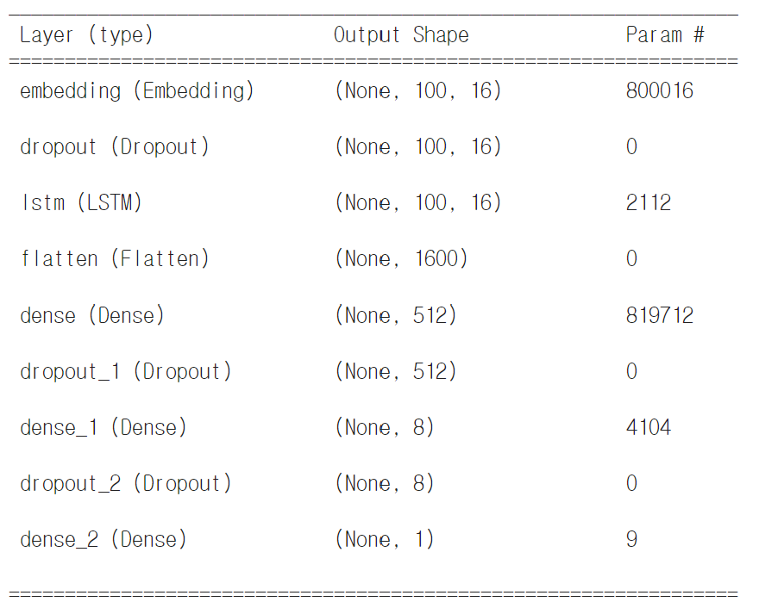
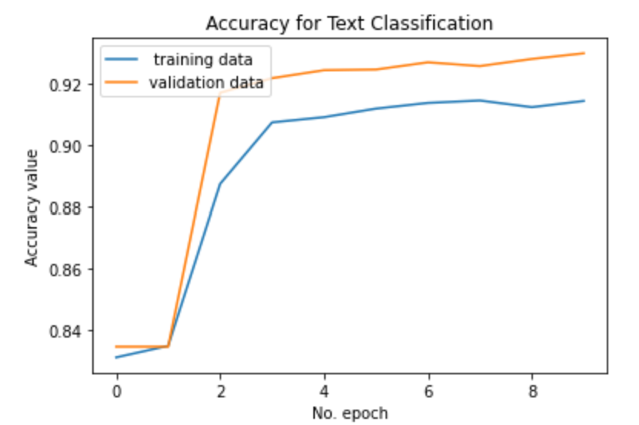
LSTM
Tensorflow and keras sequential model used to build LSTM model.
embedding layer
dropout layer
LSTM layer
Flatten layer
Three dense layers and dropout layers
For middle dense layers, ‘relu’ activation function was used and for the final dense layer, ‘sigmoid’ function was used.
Epoch was set as 10 and we could see in each epoch, the loss decreased and the accuracy increased.

Slide 26
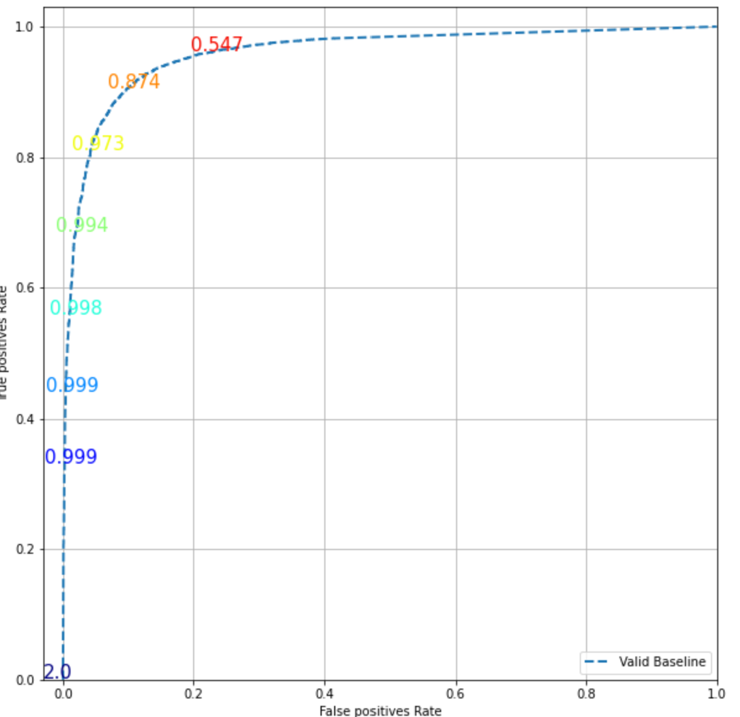
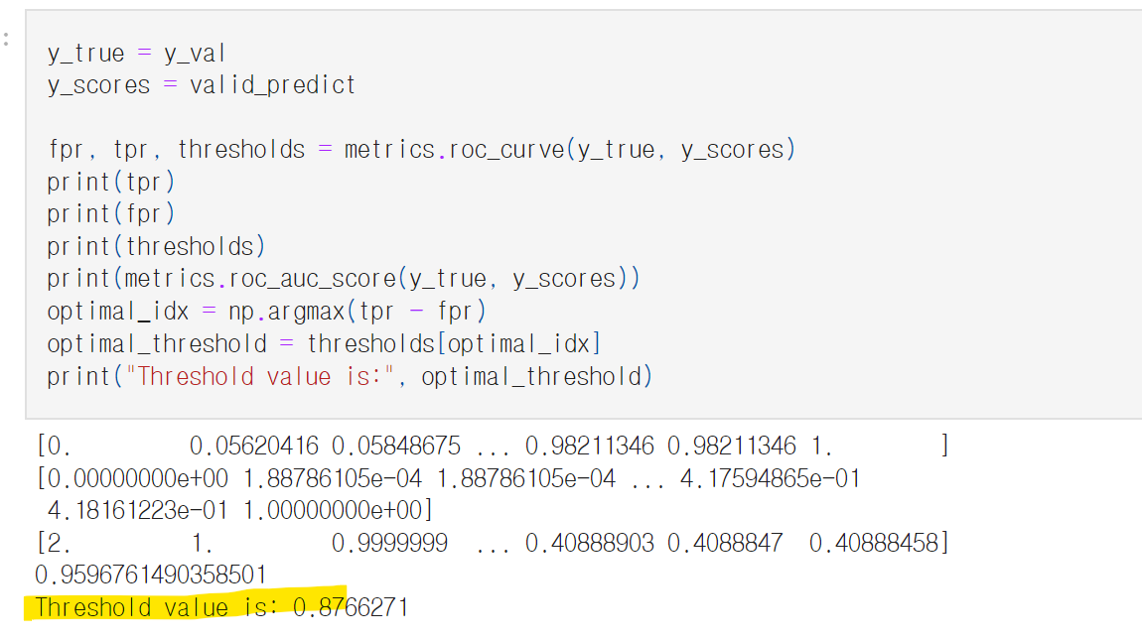
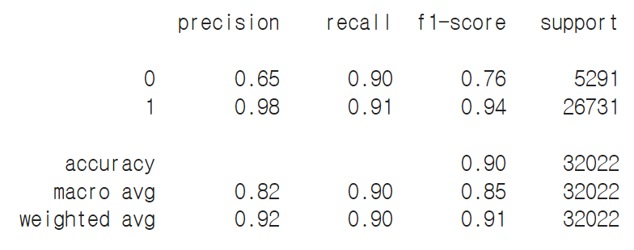
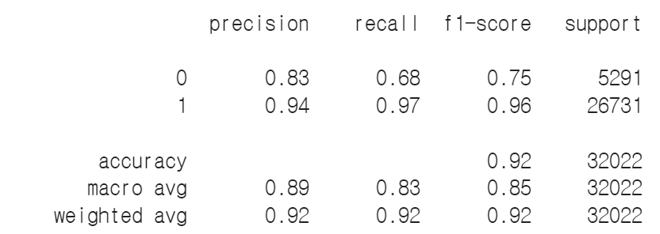
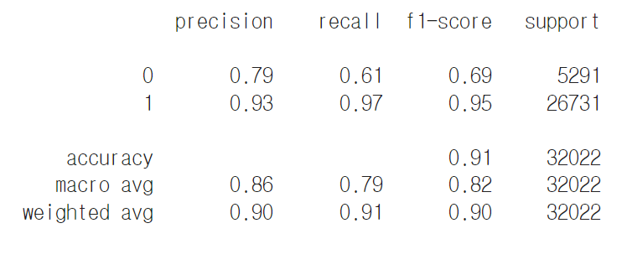
LSTM
ROC curve
Finding threshold
Keras, threshold = 0.87
Keras, threshold = 0.5
word2vec, threshold = 0.5
To determine the threshold, ROC curve was looked and found the threshold value as 0.87 and
the accuracy was 90%
When we changed the threshold to 0.5 to see the effects, found out that the accuracy got higher to 92%
The model with word2vec had slightly lower accuracy than one with keras.

Slide 27
04
KEY FINDINGS

Slide 28
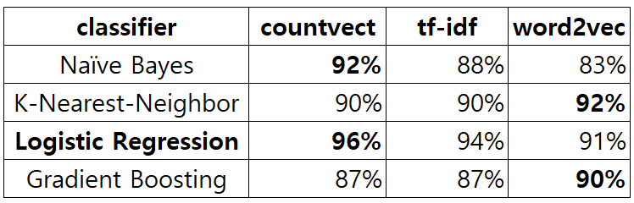
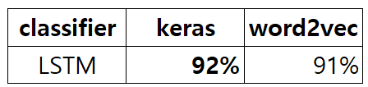
KEY FINDINGS
We explored 5 models : Naive Bayes, Logistic Regression, KNN, Gradient Boosting, and LSTM for Sentiment Analysis problem with Amazon product review data.
Among 5 models, Logistic Regression performed the best with the dataset in this project.
it’s not that one is better than others but sometimes countvect performed better and sometimes word2vec performed better than others. So when selecting models and vectorizing methods we found that it’s good to try various combinations of them and see what performs better.

Slide 29
KEY FINDINGS
When determining the threshold of probability to classify, not only the ROC curve but also data structure can be considered.
The data we used in this project was skewed data which had far more positive reviews than negative reviews, so when the threshold for a more true positive rate was set, it had higher accuracy.
Finally, the results showed that not always complex and the latest model performs better than the others, classic models can perform well like logistic regression. We could learn that model selection is not a simple work that should include considering training and computing time, data structure and feature, method, hyperparameter, overfitting, deciding evaluation matrix, etc comprehensively through this project.

Slide 30

Thank you

